Slide 1
Vision Extract: Subject Isolation through Image Segmentation
An AI-powered approach for automatic subject isolation
Submitted By: Mounica Vaishnavi
Guided By: Suman Sir

Slide 2
INTRODUCTION
VisionExtract is an advanced deep learning project aimed at automating the process of subject isolation from digital images. The system employs semantic segmentation techniques to accurately differentiate the main subject from its background at the pixel level.This approach minimizes manual intervention and enhances the efficiency of image editing and processing workflows.The model has been deployed as an interactive Streamlit web application, enabling real-time image upload and subject extraction.

Slide 3
PROBLEM STATEMENT
Manual subject isolation from images is time-consuming, error-prone, and often dependent on expensive or limited software tools. There is a need for an automated, efficient, and accurate method to extract the main subject from any image.
Challenge:
Goal:
AI:
Automatically isolating subjects from complex backgrounds requires high pixel accuracy.
Achieve accurate subject isolation from diverse backgrounds
Leverage deep learning for automated segmentation

Slide 4
OBJECTIVES
Main Objective:
To develop an intelligent image segmentation system, VisionExtract, capable of automatically isolating the main subject from any image using deep learning.
Key Objectives:
Implement semantic segmentation to achieve pixel-level subject extraction with high accuracy.
Enable users to upload images and generate isolated subject outputs automatically.
Provide side-by-side visualization of the original and masked images for better comparison.
Allow users to download the masked images seamlessly.
Deploy the complete pipeline on Streamlit, ensuring a clean, user-friendly, and interactive interface.
Optimize model performance through fine-tuning and evaluation using metrics like IoU and Dice Coefficient.

Slide 5
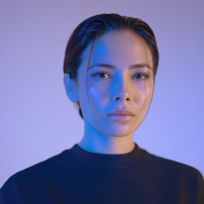
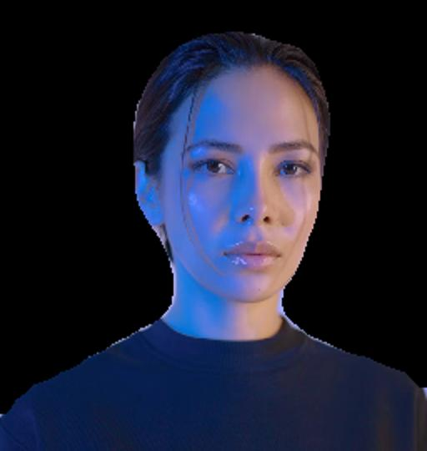
Use Case: Automated Subject Isolation
BEFORE
AFTER
Instant subject extraction from any image
High-precision mask generation
Real-time processing capabilities

Slide 6
DATASET INFORMATION
COCO 2017 dataset provides comprehensive annotations for training robust segmentation models
DATASET | IMAGES | ANNOTATIONS | CLASSES | SOURCE
COCO 2017 | 118,287 | 1.5M+ | 80 | Kaggle
Training | 82,783 | 1.0M+ | 80 | COCO
Validation | 40,504 | 500K+ | 80 | COCO

Slide 7
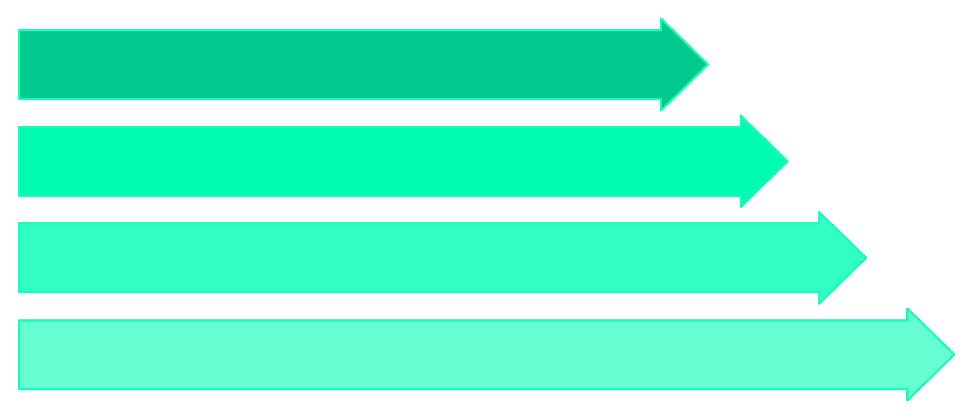
VisionExtract Development Workflow
Preprocessing
Model Training
Evaluation
Inference
Our development journey spanned a comprehensive pipeline, ensuring robust performance from data preparation to deployment.

Slide 8



Evaluation: Metrics and Visual Prowess
0.87
0.91
94%
IoU Score
Dice Coefficient
Overall Accuracy
Intersection over Union (IoU) indicating strong overlap between predicted and ground truth masks.
Reflecting excellent similarity and contour accuracy of the segmented subjects.
High pixel-level accuracy in distinguishing subjects from backgrounds.

Slide 9
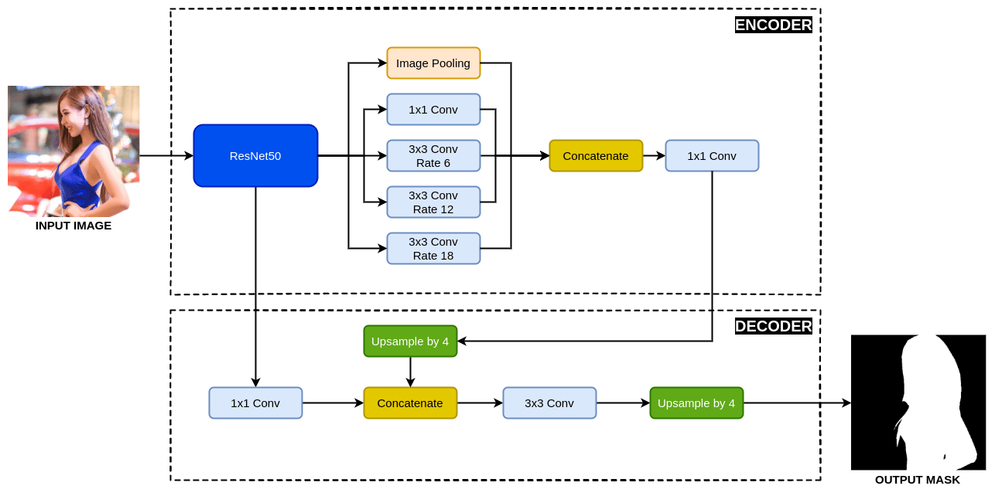
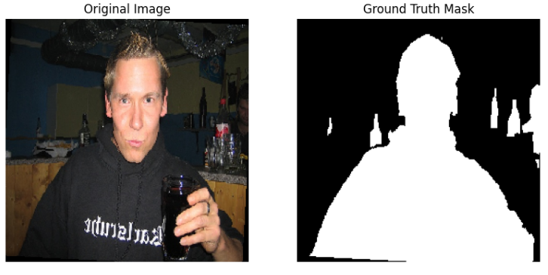
Model Architecture: DeepLabV3 with ResNet-50 Backbone
VisionExtract is powered by the DeepLabV3 architecture, a state-of-the-art deep learning model for semantic image segmentation.
It utilizes a ResNet-50 backbone to extract high-level image features while preserving spatial details.
The model employs Atrous (dilated) convolutions to capture objects at multiple scales and improve boundary precision.
A combination of Binary Cross-Entropy and Dice Loss is used for accurate subject-background separation.
The output layer uses a Sigmoid activation to produce a clean binary mask highlighting the isolated subject.
DeepLabV3’s multi-scale context understanding enables robust subject isolation even in complex backgrounds.

Slide 10



Overcoming Challenges: Fine-Tuning for Perfection
Hyperparameter Tuning
Edge Cases
Data Augmentation
Optimizing learning rate, batch size, and network depth
Handling complex backgrounds and overlapping objects
Balancing augmentation techniques to prevent overfitting
Each challenge presented an opportunity for refinement, leading to a more resilient and accurate model.

Slide 11
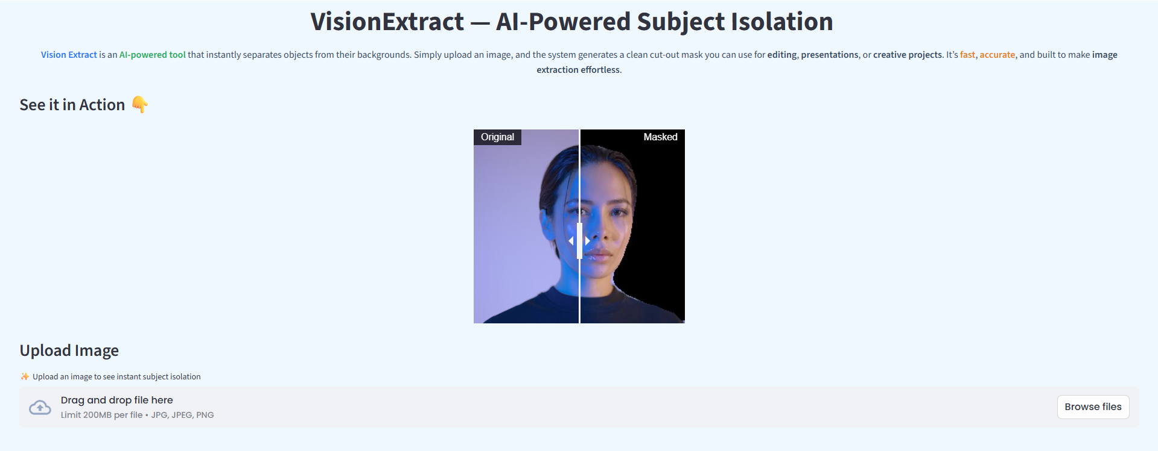
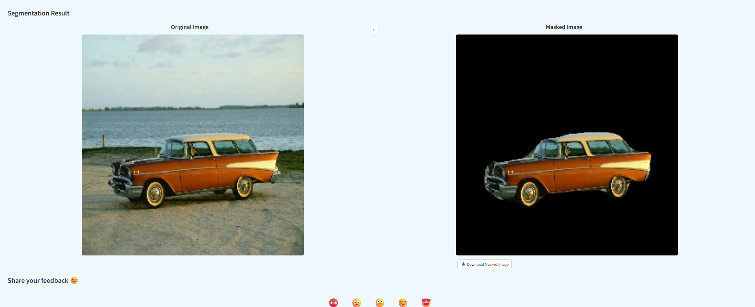
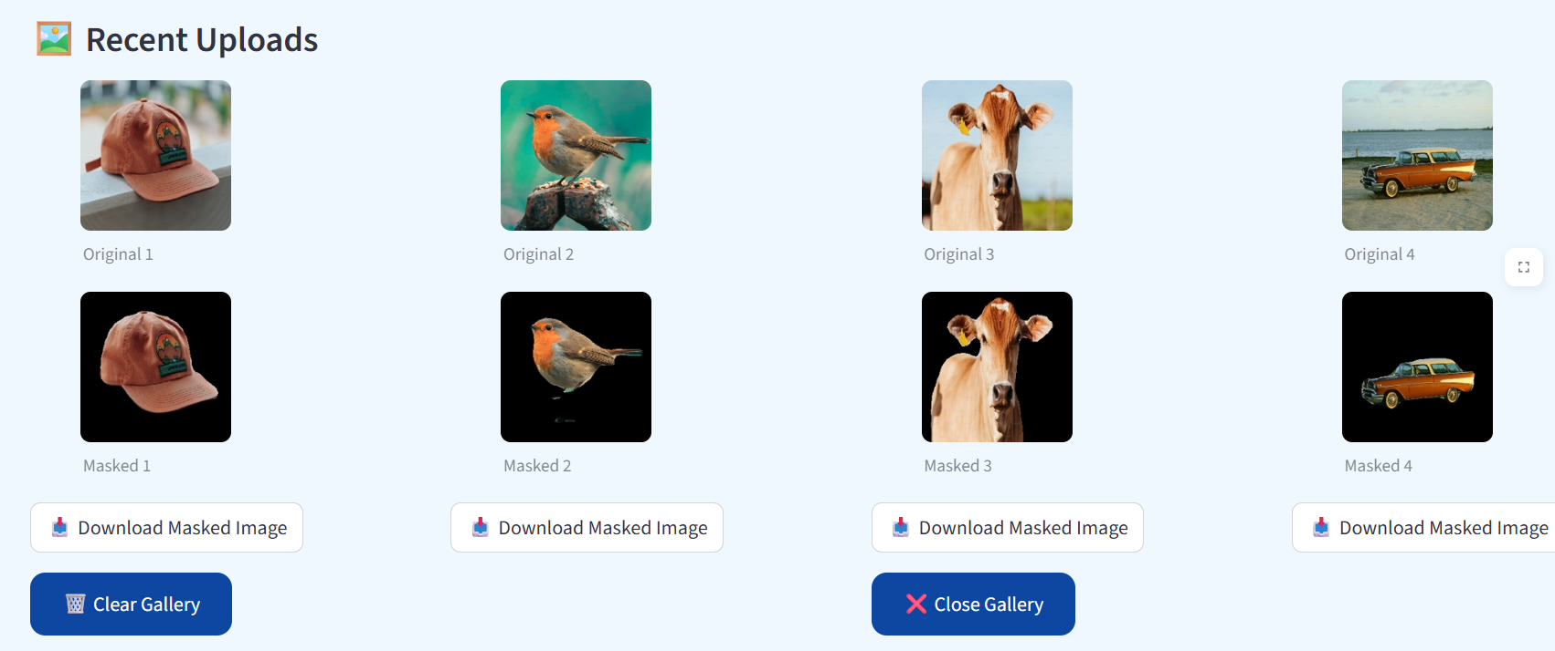
Deployment: VisionExtract Live on Streamlit
VisionExtract is deployed as an intuitive web application using Streamlit, making advanced segmentation accessible to everyone.
Upload Image:
Easily submit your own images for processing.
View Result:
Instantly see the segmented subject against a clean background.
Download Mask:
Obtain the isolated subject for further creative use.
Show Gallery:
It displays all previously uploaded and processed images, allowing users to easily view, compare, and download their past results.
Experience VisionExtract live:
https://visionextract.streamlit.app

Slide 12
CONCLUSION
VisionExtract successfully automates the process of subject isolation using deep learning–based image segmentation.By leveraging the U-Net architecture, it accurately separates the main subject from complex backgrounds with minimal human effort.The project demonstrates the power of semantic segmentation in real-world applications like digital editing and AR/VR.Its Streamlit-based interface ensures an interactive and user-friendly experience for non-technical users.Overall, VisionExtract bridges the gap between advanced AI models and practical image manipulation, making segmentation accessible to everyone.

Slide 13
THANK YOU

